Slide 1
Source: UCI Machine Learning Repository
EXPLORATORY DATA ANALYSIS
Forest Fires Dataset (Montesinho Natural Park, Portugal)
Group 2
Submitted by: Course / Department:BCA div -b Guided by: Roll: No: Date: 5/10/26

Slide 2
-Index
.
.
.
1. Introduction and Objective
2. Dataset Description 3
3. Data Type and Variables
4. Tools Used for Analysis
5. Data Quality 6. Descriptive Statistics
6. Univariate Analysis
7. Grouping and Aggregation
8. Bivariate Analysis
9. Correlation Analysis
10. Key Findings
11.Conclusion
12.References
Appendix: Python Source Code

Slide 3
1. Introduction and Objective
Forest fires can have a big impact on nature, buildings, and people By learning what affects the size of a fire and the weather that goes with it, forest managers can use their resources better. This project looks into the Forest Fires dataset from Montesinho Natural Park in the northeast of Portugal to explore these factors.
Objectives
1. To understand the structure, variables and quality of the dataset.
2. To summarise the weather and fire-index variables using descriptive statistics.
3. To study the distribution of each variable and of the burned area
. 4. To compare fires across months, seasons and days of the week.
5. To find which variables are related to the burned area.

Slide 4
2. Dataset Description
The dataset was published by Cortez and Morais (2007) and is available from the UCI Machine Learning Repository. It contains 517 records and 13 original columns. Each row is one forest fire event. The columns give the location inside the park, the date, four fire-weather indices from the Canadian Fire Weather Index (FWI) system, four meteorological readings and the burned area in hectares. The target variable is area (burned area in ha).
x | y | Month | Day | FFMC | DMC | DC | ISI | temp | RH | Wind | rain
7 | 5 | Mar | Fri | 86.2 | 26.3 | 94.3 | 5.1 | 8.2 | 51 | 6.7 | 0.0 | 0.0
7 | 4 | Oct | Tue | 90.2 | 35.4 | 669.1 | 6.7 | 18.0 | 33 | 0.9 | 0.0 | 0.0
7 | 4 | Oct | Sat | 90.2 | 43.7 | 686.9 | 6.7 | 14.6 | 33 | 1.3 | 0.0 | 0.0
8 | 6 | Mar | Fri | 91.2 | 33.3 | 77.5 | 9.0 | 8.3 | 97 | 4 | 0.2 | 0.0
8 | 6 | Mar | Sun | 89.3 | 51.3 | 102.2 | 9.6 | 11.4 | 99 | 1.8 | 0.0 | 0.0
8 | 6 | Aug | Sun | 92.3 | 85.3 | 488.0 | 14.7 | 22.2 | 29 | 5.4 | 0.0 | 0.0
8 | 6 | Aug | Mon | 92.3 | 88.9 | 495.6 | 8.5 | 24.1 | 27 | 3.1 | 0.0 | 0.0
8 | 6 | Aug | Mon | 91.5 | 145.4 | 608.2 | 10.7 | 8.0 | 86 | 2.2 | .0.0 | 0.0
8 | 6 | aug | mon | 91.5 | 145.4 | 608.2 | 10.7 | 8.0 | 86 | 2.2 | 0.0 | 0.0
x | y | month | day | FFMC | DMC | DC | ISI | temp | RH | WID

Slide 5
Variables
Numeric: X, Y, FFMC, DMC, DC, ISI, temp, RH, wind, rain, area
Categorical: month, day
Example rows shown for context

Slide 6
.
Variab;e | type | Meaming
X | Numeric (discrete) | X axis spatial coordinate(1-9)
Y | Numeric (discrete) | Y axis spatial coordinate(2-9)
Month | Categorical | Month of the year
Day | Categorical | Day of the week
FFMC | Numeric (continuous) | Fine fuel Moisture code
DMC | Numeric (continuous) | Duff Mouisture code
DC | Numeric (continuous) | Drougth code
IDI | Numeric (continuous) | Intial spread index
Temp | Numeric (continuous) | Temperature
RH | Numeric (discrete) | Relative humidity(%)
Wind | Numeric (continuous) | Wind speed(km/h)
Rain | Numeric (continuous | Outside rain(mm/m2)
area | Numerical (continues) | Burnd area(ha)

Slide 7
4. Tools Used for Analysis
• Python 3 - programming language used for the whole analysis. • Pandas - bringing in the data, tidying it up, organizing, and summarizing. • NumPy - numerical calculations such as the log transformation. • Matplotlib and Seaborn - histograms, box plots, bar charts, scatter plots and heatmap. • ReportLab - generating this PDF report. • Excel / CSV - the data file forestfires.csv from the UCI repository.

Slide 8
Data Quality
    No missing values
4 duplicate rows retained
48% of fires recorded as 0 ha
Burned area highly skewed (skewness 12.85)
63 large outliers kept
Check | Result
Rows | 517
Columns | 13
Missing values | 0
Duplicate rows | 4
Fires with area = 0 | 247(47.8%)
Outliers in area (IQR rule) | 63
.
.
l
.
.

Slide 9
There are 0 missing values, so no imputation was needed. 4 duplicate row(s) were found (these look like separate fires with identical readings, so they were kept). A total of 247 records (47.8%) have a burned area of 0, which means the burned area was less than 1 ha and was rounded down to 0 in the original data. The area variable is heavily right-skewed (skewness 12.85), with 63 outliers by the IQR rule. These are real large fires, so they were kept, and a log(1 + area) transformation was used for plotting. index mis.
In dex | Missing
X | 0
Y | 0
Month | 0
Day | 0
FFMC | 0
DMC | 0
DC | 0
ISI | 0
Temp | 0
RH | 0
Wind | 0
Rain | 0
Area | 0
Burnd | 0
Log_area | 0
Season | 0
Tband | 0

Slide 10
Descriptive Statistics
The average temperature is 18.89 deg C and the average relative humidity is 44.29%. The mean burned area is 12.85 ha while the median is 0.52 ha, and the maximum is 1090.84 ha. Since the mean is far above the median, a few very large fires pull the average up. Rain is almost always 0 (mean 0.02 mm).

Slide 11
The average temperature is 18.89 deg C and the average relative humidity is 44.29%. The mean burned area is 12.85 ha while the median is 0.52 ha, and the maximum is 1090.84 ha. Since the mean is far above the median, a few very large fires pull the average up. Rain is almost always 0 (mean 0.02 mm).
index | Count | mean | Std | min | 25% | 50% | 75% | Max
X | 517.0 | 4.67 | 2031 | 1.0 | 3 | 4 | 7.0 | 9.0
Y | 517.0 | 4.3 | 1.23 | 2.0 | 4 | 4 | 5.0 | 9.0
FFMC | 517.0 | 90.64 | 5.52 | 18.7 | 90.2 | 91.6 | 92.9 | 96.2
DMC | 517.0 | 110.87 | 64.05 | 1.1 | 68.2 | 108.3 | 142.4 | 291.3
DC | 517.0 | 547.94 | 248.07 | 7.9 | 437.7 | 664.2 | 713.9 | 860.6
ISI | 517.0 | 9.02 | 4.56 | 0.0 | 6.5 | 8.4 | 10.8 | 56.1
Temp | 517.0 | 18.87 | 5.81 | 2.2 | 15.5 | 19.3 | 22.8 | 33.3
RH | 517.0 | 44.29 | 16.32 | 15.0 | 33.0 | 42.0 | 53.0 | 100.0
Wind | 517.0 | 1.02 | 1.79 | 0.4 | 2.7 | 4.0 | 4.9 | 9.4
Rain | 517.0 | 0.02 | 0.3 | 0.0 | 0.0 | 0.0 | 0.0 | 6.4
area | 517.0 | 12.85 | 63.66 | 0.0 | 0.0 | .52 | 6.67 | 1090.84

Slide 12
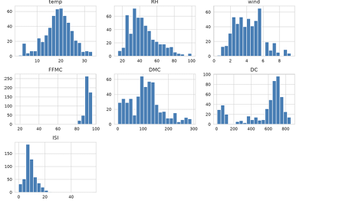
7. Univariate Analysis
7.1 Distribution of weather and fire indices

Slide 13
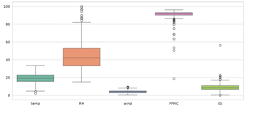
7.2 Box plots

Slide 14
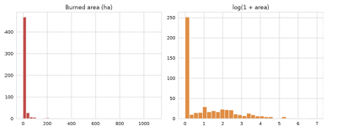
7.3 Burned area
Most fires are small and a few are huge. After the log transformation the distribution is easier to read. The spike at zero is the 247 fires with no recorded area.

Slide 15
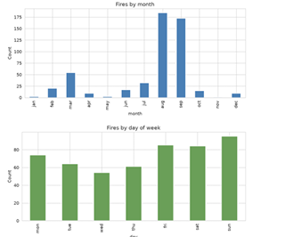
7.4 Month and day
The most fires occurred in aug (184 fires), followed by sep (172), mar (54). Weekends are busier: sun has 95 and fri 85 fires, against 54 on wed.

Slide 16
8. Grouping and Aggregation
8.1 By season
Season | fires | Mean_area | Total_area | Mean_temp
Winter | 31 | 7.92 | 245.47 | 7087
Spring | 65 | 5.44 | 353.76 | 12.99
Summer | 233 | 12.26 | 2857.12 | 21.61
autumn | 188 | 16.95 | 3185.7 | 19.37

Slide 17
8.2 By day of week
day | fires | Mean61_area
Mon | 74 | 9.55
Tue | 64 | 12.62
Wed | 54 | 10.71
thu | 61 | 16.35
Fri | 85 | 5.26
Sat | 84 | 25.53
Sun | 95 | 10.1

Slide 18
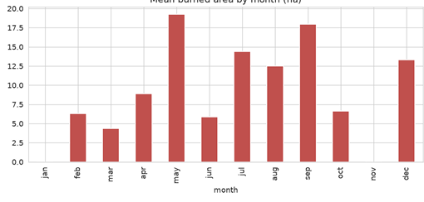
8.3 Mean burned area by month
The highest mean burned area is in may (19.2 ha). Note that months with few fires can have a high average because of one large fire.

Slide 19
8.4 Burned vs not burned (area > 0)
Burned | temp | RH | wind | FFMC | DMC | DC | ISI
No area(0) | 18.43 | 44.89 | 3.91 | 90.22 | 106.68 | 522.88 | 8.85
Burned(>0) | 19.31 | 43.73 | 4.11 | 91.03 | 114.71 | 570.87 | 9.18

Slide 20
8.5 By temperature band
tband | fire | Mean_area | Pct_burnd
Low(<15C) | 113 | 5.61 | 0.48
Mediium(15-25C) | 339 | 9.85 | .52
High(>25C) | 65 | 41.03 | 0.62

Slide 21
8.6 Five largest fires in
INDEX | MONTH | DAY | TEPM | RH | wiIND | AREA
238 | SEP | SAT | 25.1 | 27 | 4.0 | 1090.84
415 | AUG | THU | 27.5 | 27 | 4.9 | 746.28
479 | JUL | MON | 22.6 | 57 | 4.9 | 278.53
237 | SEP | TUE | 18.8 | 40 | 2.2 | 212.88
236 | SEP | SAT | 18.2 | 46 | 1.8 | 200.94

Slide 22
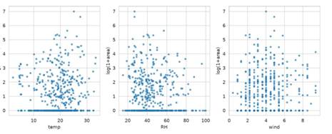
9. Bivariate Analysis
9.1 Weather vs burned area

Slide 23
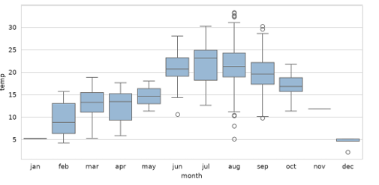
9.2 Temperature across months

Slide 24
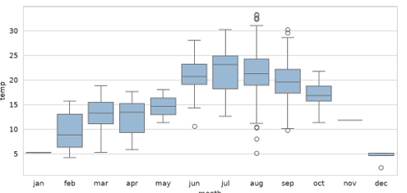
9.2 Temperature across months

Slide 25
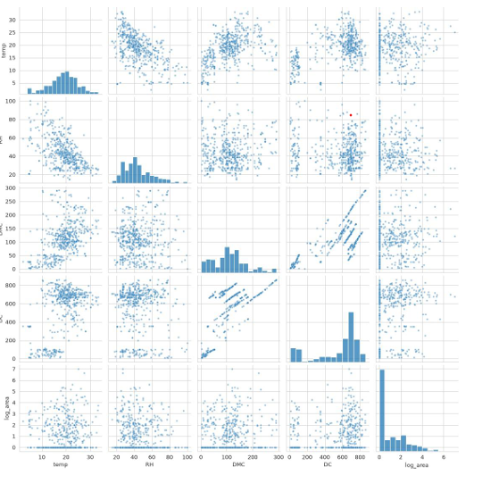
9.3 Pair plot

Slide 26
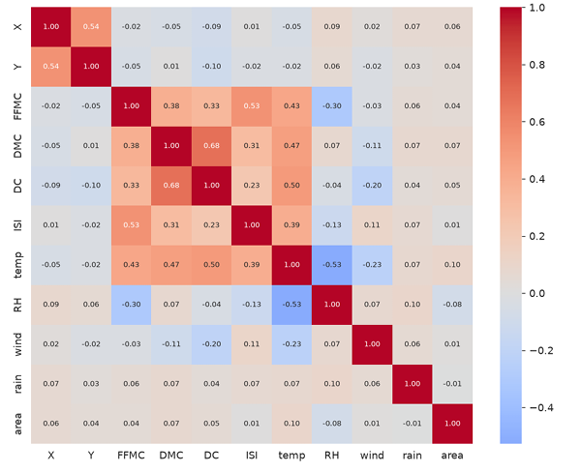
10. Correlation Analysis
Strongest correlations between variables: DMC and DC (0.68); X and Y (0.54); FFMC and ISI (0.53); temp and RH (-0.53); DC and temp (0.50). DMC and DC are strongly linked because both measure dryness of deeper layers, and ISI is related to FFMC. Correlation with burned area: temp (0.10), RH (-0.08), DMC (0.07), X (0.06), DC (0.05). All are below 0.1 in size, so burned area is hard to predict from these variables alone. Correlation does not prove cause.

Slide 27
Key Findings
1. The data is clean: 0 missing values. 2. Burned area is highly right-skewed. 48% of fires are under 1 ha, and the largest is 1090.84 ha. 3. Aug has the most fires; summer and autumn dominate. 4. Fires occur more frequently on weekends Friday, Saturday, and Sunday which may be associated with increased human activity. 5. FFMC is high (median 91.6) for most fires, i.e. fuel is dry. 6. Fires burn with higher mean temperature in the 'burned' group (19.31 vs 18.43 deg C), but the correlation with area is weak. 7. DMC and DC are strongly correlated (0.68). 8. No single variable explains the burned area well.

Slide 28
Conclusion
.
This EDA studied 517 forest fire records from Montesinho Park. The data had no missing values and was easy to work with. Fires are concentrated in the hot, dry months and are mostly small, with a few extreme events driving the average area. The weather and index variables show only weak linear relationships with burned area, so predicting fire size is difficult and would need non-linear models or extra information. The results can help forest managers focus prevention work on late summer and weekends.

Slide 29
13. References
1. , P. and Morais, A. (2007). Using weCortezather data to predict forest fires with data mining. Presented at the 13th EPIA Conference, held in Portugal in 2007 2. Machine Learning Repository: https://archive.ics.uci.edu/dataset/162/forest+fires 3. Pandas documentation. https://pandas.pydata.org 4. Matplotlib documentation. https://matplotlib.org 5. Seaborn documentation. https://seaborn.pydata.org Forest 6. Canadian Forest Fire Weather Index System, Natural Resources Canada. Fires dataset.

Slide 30
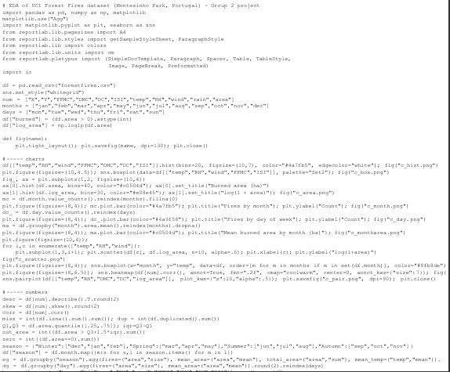
Appendix: Python Source Code

Slide 31
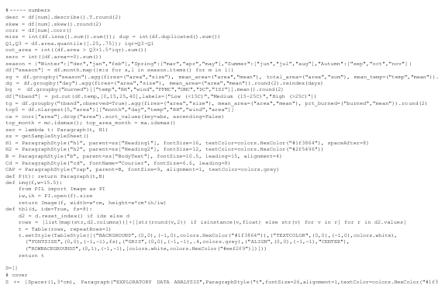

Slide 32
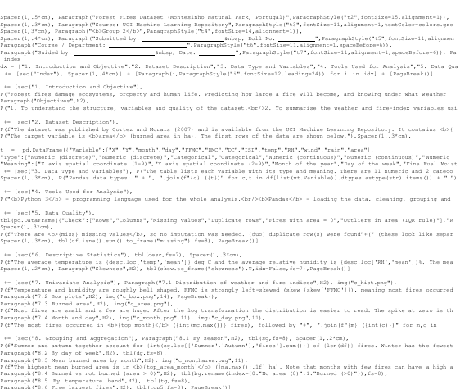

Slide 33
